Slide 1
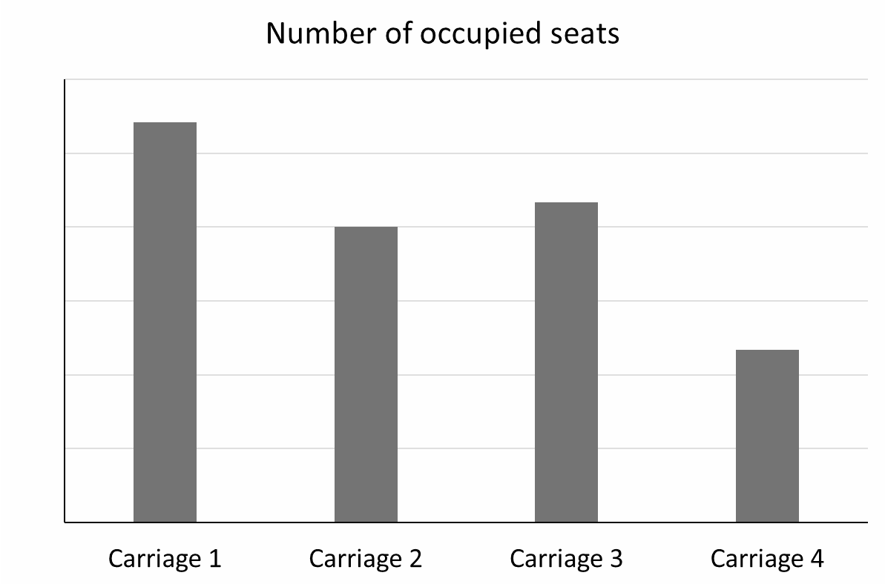
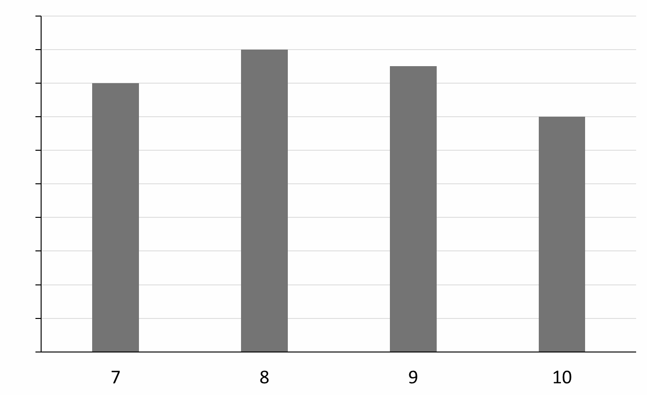
Securing constructing bar charts by hand
Task A: Constructing and interpreting bar charts
Complete the vertical scale.
48
Complete the frequency table and bar chart.
sweets per pack | frequency
7 | 16
8
9 | 17
10 | 14
Sweets per pack

Slide 2
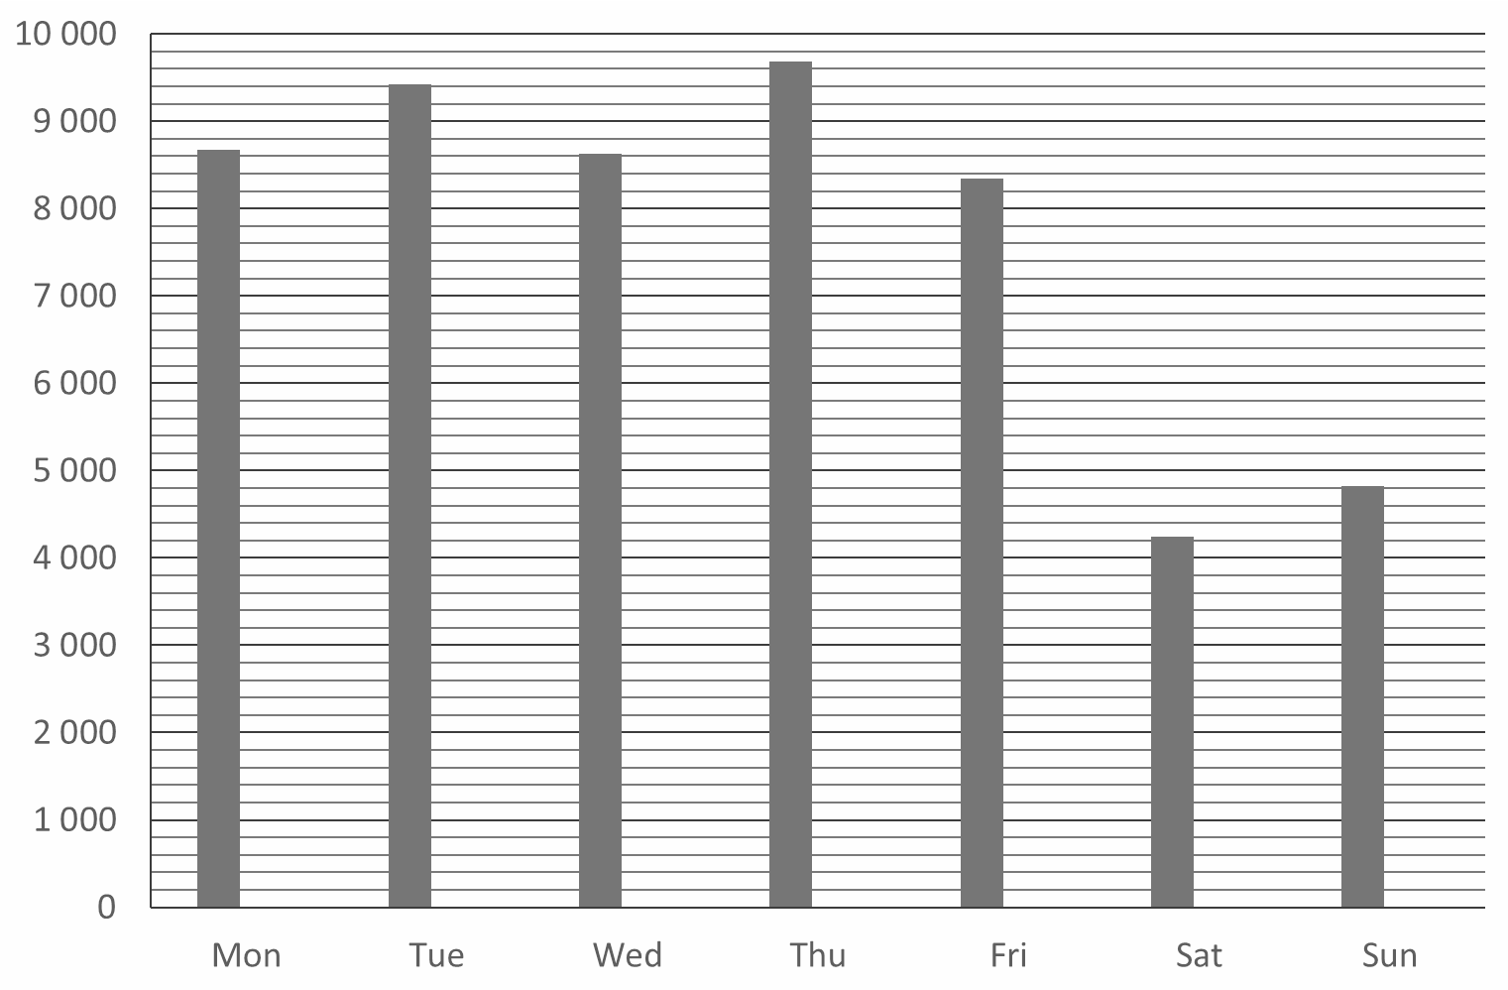
Securing constructing bar charts by hand
Task B: Using bar charts in a data investigation
Decide whether each data set should be ordered or not.
Colours of karate belts
Animals at a zoo
Types of pen
Movie genres
Clothing sizes
Jacob wants to see if there is any trend to his step count. He collects data over a two week period. Week one is displayed,
add week two to the bar chart.
Frequency
Week 2
Mon | 8 600
Tue | 8 900
Wed | 8 700
Thu | 9 300
Fri | 9 100
Sat | 4 500
Sun | 4 700
Days
b) What comments can you make regarding Jacob’s daily step count? Justify your comments.
Mathematics in Education and Industry.
v2.1

